Slide 1
Mapping The Galactic Plane
Kenji Doi, David Halperin, Mason Hoey, Patrick Jackson, John McDougal

Slide 2
Goals
Main Goal
The overall goal for this experiment was to study the 21 cm line of hydrogen using a radio telescope created in class.
Secondary Goal
Demonstrate our ability to understand how to build and test hardware and software in a group setting.

Slide 3
Horn
Materials:
Horn
Styrofoam + Aluminum foil + Duct tape
Can
1 gal Aluminum Thinner Can + Duct tape
Dimensions:
Base 74.4*59.0 cm
Top 16.9*10.5 cm
Height 69.5 cm
Can 16.9*10.5*25.1 cm

Slide 4
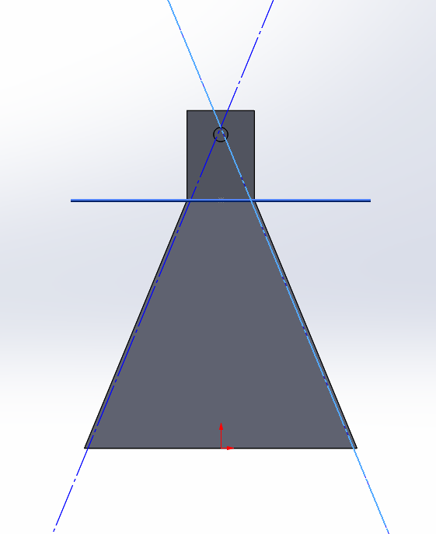
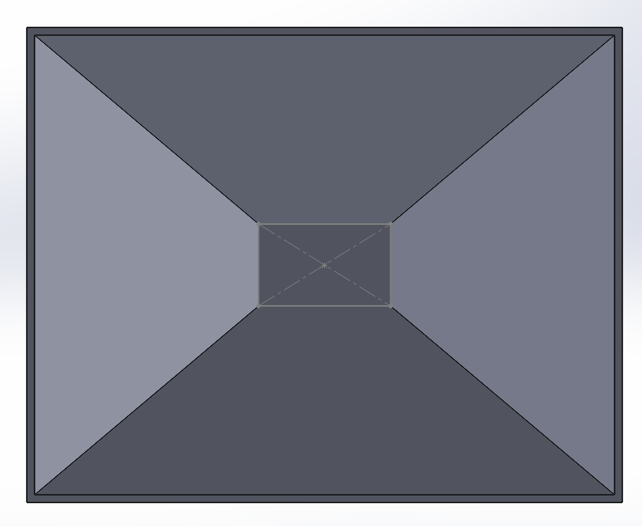
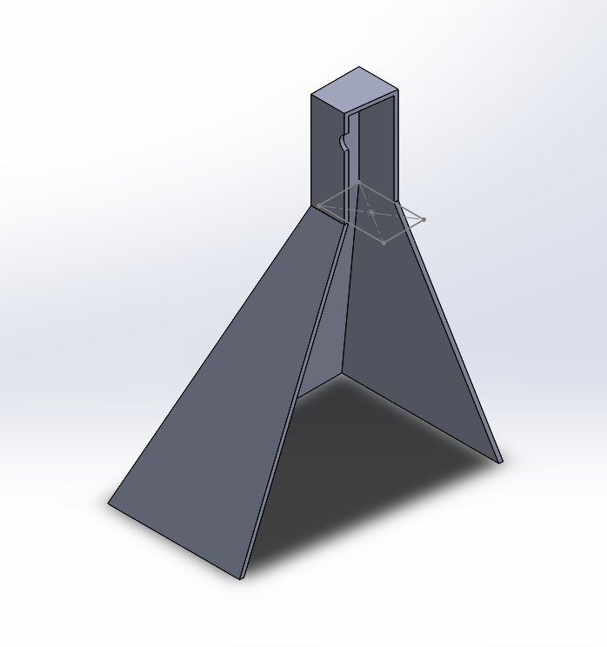
Pictures

Slide 5
Issues & Solutions
Material Issue: Aluminum sheet is expensive. Takes too much effort to construct
Solution: Change material to styrofoam ! Cheap, easy to cut and adjust.
Construction Issue: Styrofoam is too light & Too fragile
Solution: Add some metals to increase wait. Also add non-conductive material inside to enforce the structure.

Slide 6
Recording Software
Raspberry Pi initially running Raspbian with GNURadio
Unable to find RTL-SDR
Ubuntu Mate used as alternative operating system with GNURadio
Soapysdr package for GNURadio was unable to be found.
RTL-SDR returned blank reading through Raspberry Pi
Testing confirmed error was with Raspberry Pi
VNA used as alternative
Manually gather data
Notes:
We initially ran the Raspberry Pi with Raspbian but after coming across some trouble getting the RTL-SDR to work with GNURadio we switched to the suggested operating system, Ubuntu Mate, and installed GNURadio. We came across an issue installing the soapysdr package for GNURadio with the error stating it couldn’t be found. After completing the flowchart to create a waterfall plot, the RTL-SDR yielded no results. We proceeded to test the spectrum analyzer on another computer and found that the instrument wasn’t the problem, so to continue we decided we had to record the information manually and move away from the raspberry pi. As an alternative we replaced the Raspberry Pi & RTL-SDR with the VNA in order to manually collect the data.

Slide 7
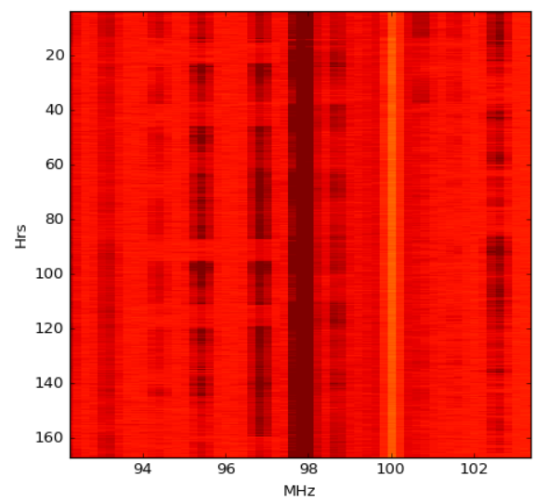
Plotting Software
Creating a spectrum of the 21-cm hydrogen line within the galactic plane.
Notes:
So my goal was to write the code to create a spectrum of the 21cm hydrogen within the galactic plane. I developed 3 graphs/plots. The idea was to get the data and put it the data file into the code. The first graph was supposed to be a waterfall; what we’re doing is taking in the 21cm lines as frequency and comparing different frequency channels over an extended period of time. We know the 21cm line comes in at 1420MHz, so that was our center point, and we chose a bandwidth of 100MHz. I chose an arbitrary hour domain of 12 hours. *What is shown here is what the waterfall is supposed to look like. The next two are were supposed to be scatter plots. One plot depicts H1 vs time; time is set to Julian Days. This plot would have shown us how hydrogen moves in the galactic plane over an extended period of time. The second plot is comparing H1 vs galactic coordinates. From this, we should have seen different hydrogen concentrations in different parts of the galactic plane at one time.

Slide 8
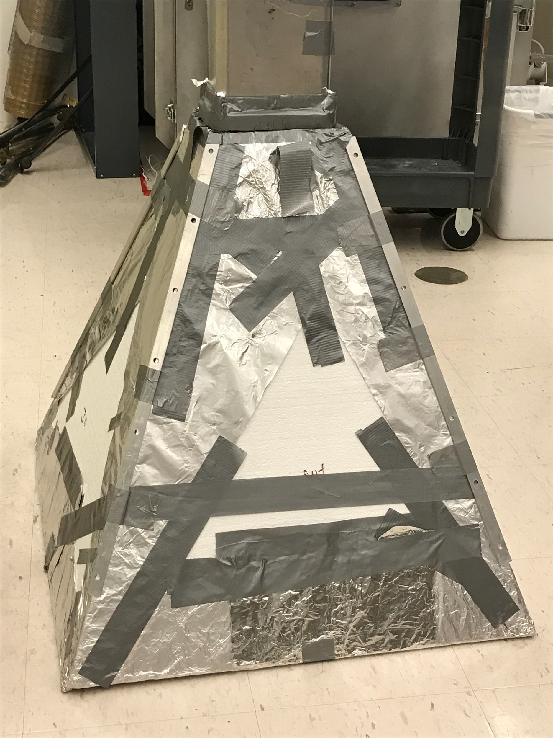
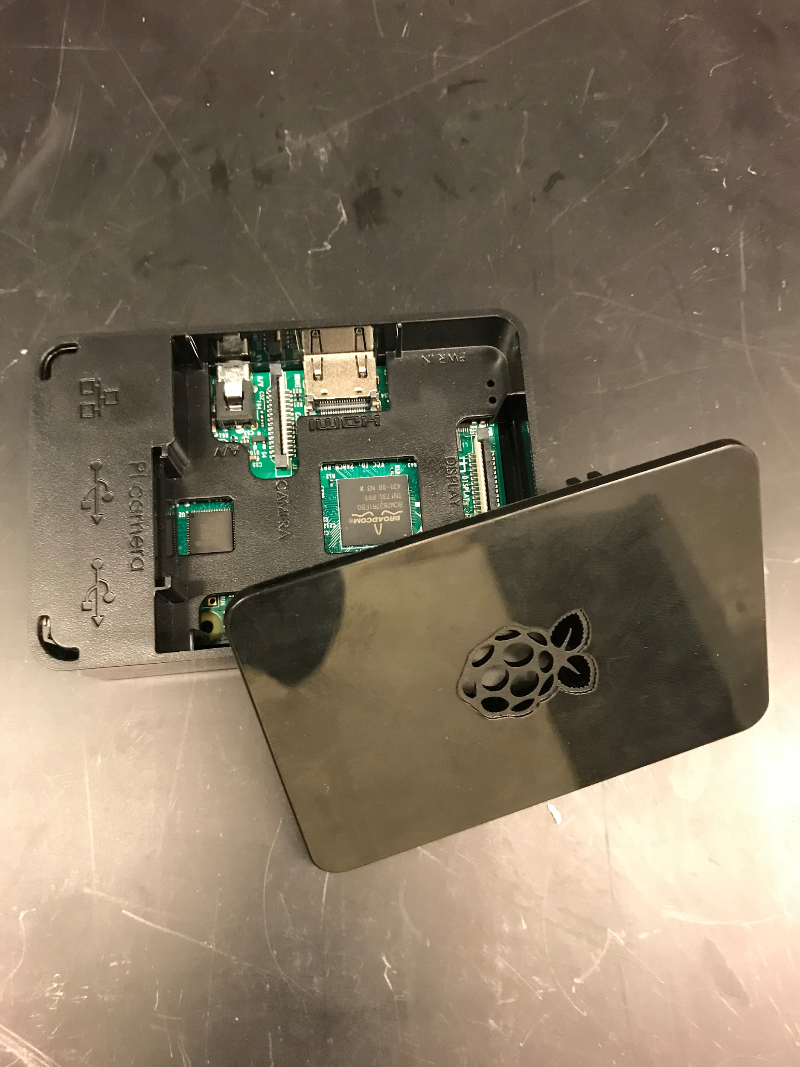
Errors & Issues
Software
Raspbian is incompatible
Ubuntu also incompatible
Mechanical
Poor construction
Materials were lackluster
Notes:
During construction we purchased foam boards with foil already on them in hopes it would act as if it were aluminum sheets. Unfortunately, the foil wasn’t conductive so we overcame the issue by covering the foam boards in foil using duct tape.
The joint between the can and the horn was just duct tape. It ended up being too heavy with not a strong enough joint and began to sag eventually falling through.
The antenna was tuned incorrectly for our test on the roof. After tuning the instrument with the horn attached we received better results in the lab.
The raspberry pi wouldnt allow us to see anything from the RTL-SDR which could have been from missing the soapysdr package.

Slide 9
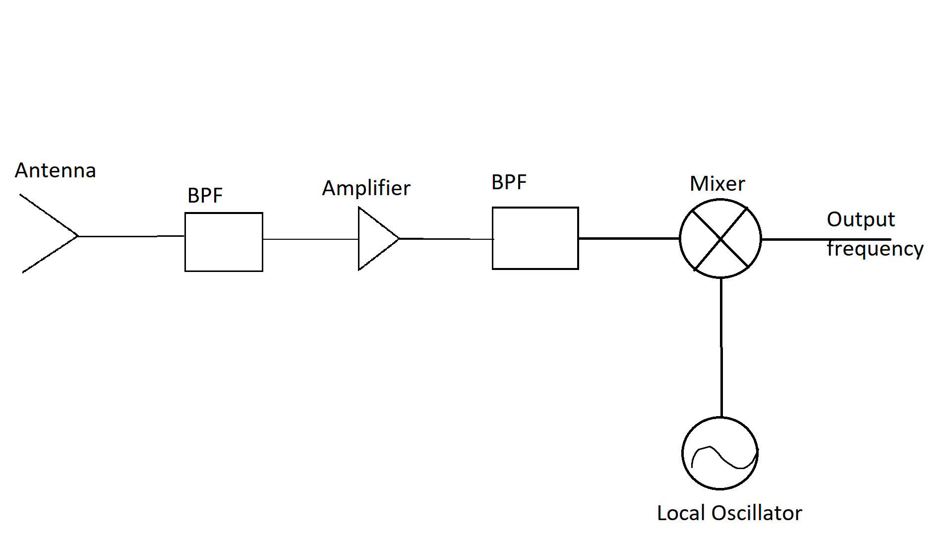
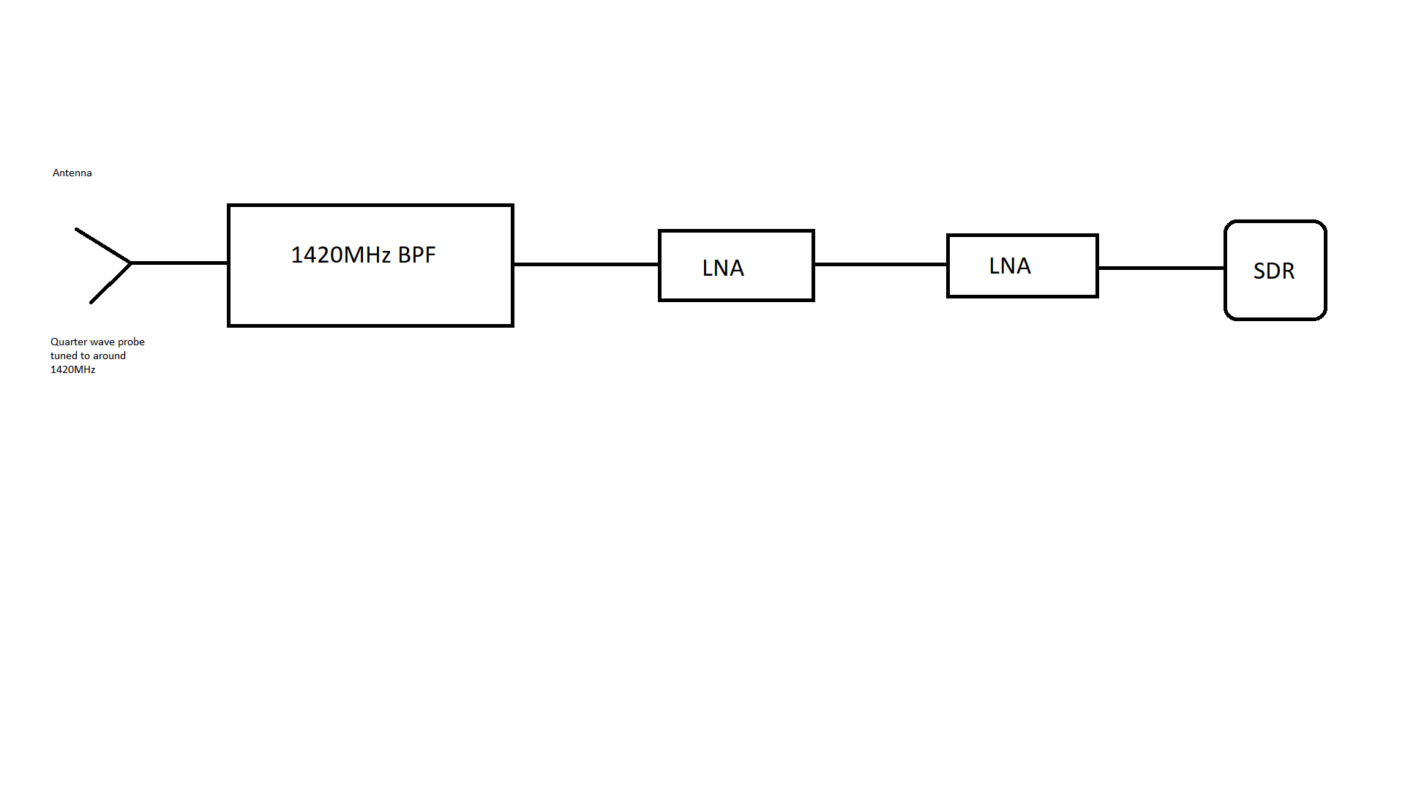
RF Front End
The original design (left) of the RF front end was to mimic a typical RF front end design.
The design used (below) instead was inspired by Rishi Patel’s design
In use design employed cascading amplifiers.
Amplifiers: ZX60-1614LN-s (+13dBm max) and ZX60-2534M-S+ (+15dBm max) (w/ 3dB 50Ohm attenuator)
BPF: K&L M/W 4FV50-1420/T60
(center of ~1420MHz and bandwidth of ~60MHz
Cascaded noise figure of 0.56dBm

Slide 10
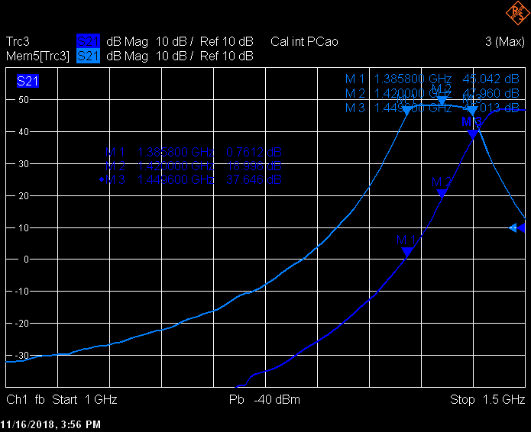
Comparing the 1420 and 1500 MHz BPFs
1420 (light blue)
Passes 1420MHz
1420MHz at center
63.8GHz bandwidth
1500 (dark blue)
Unusable, Doesn’t pass 1420MHZ between 3dB points.

Slide 11
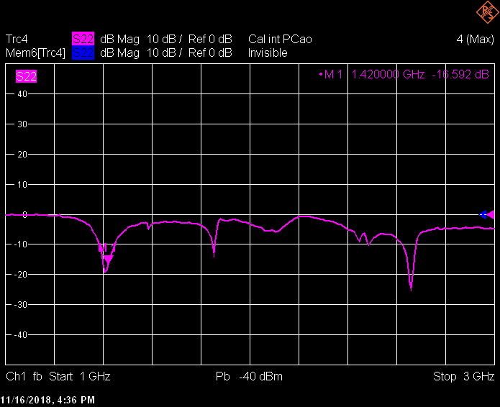
Half wave probe tuned in can
First resonance point at approximately 1420MHz

Slide 12
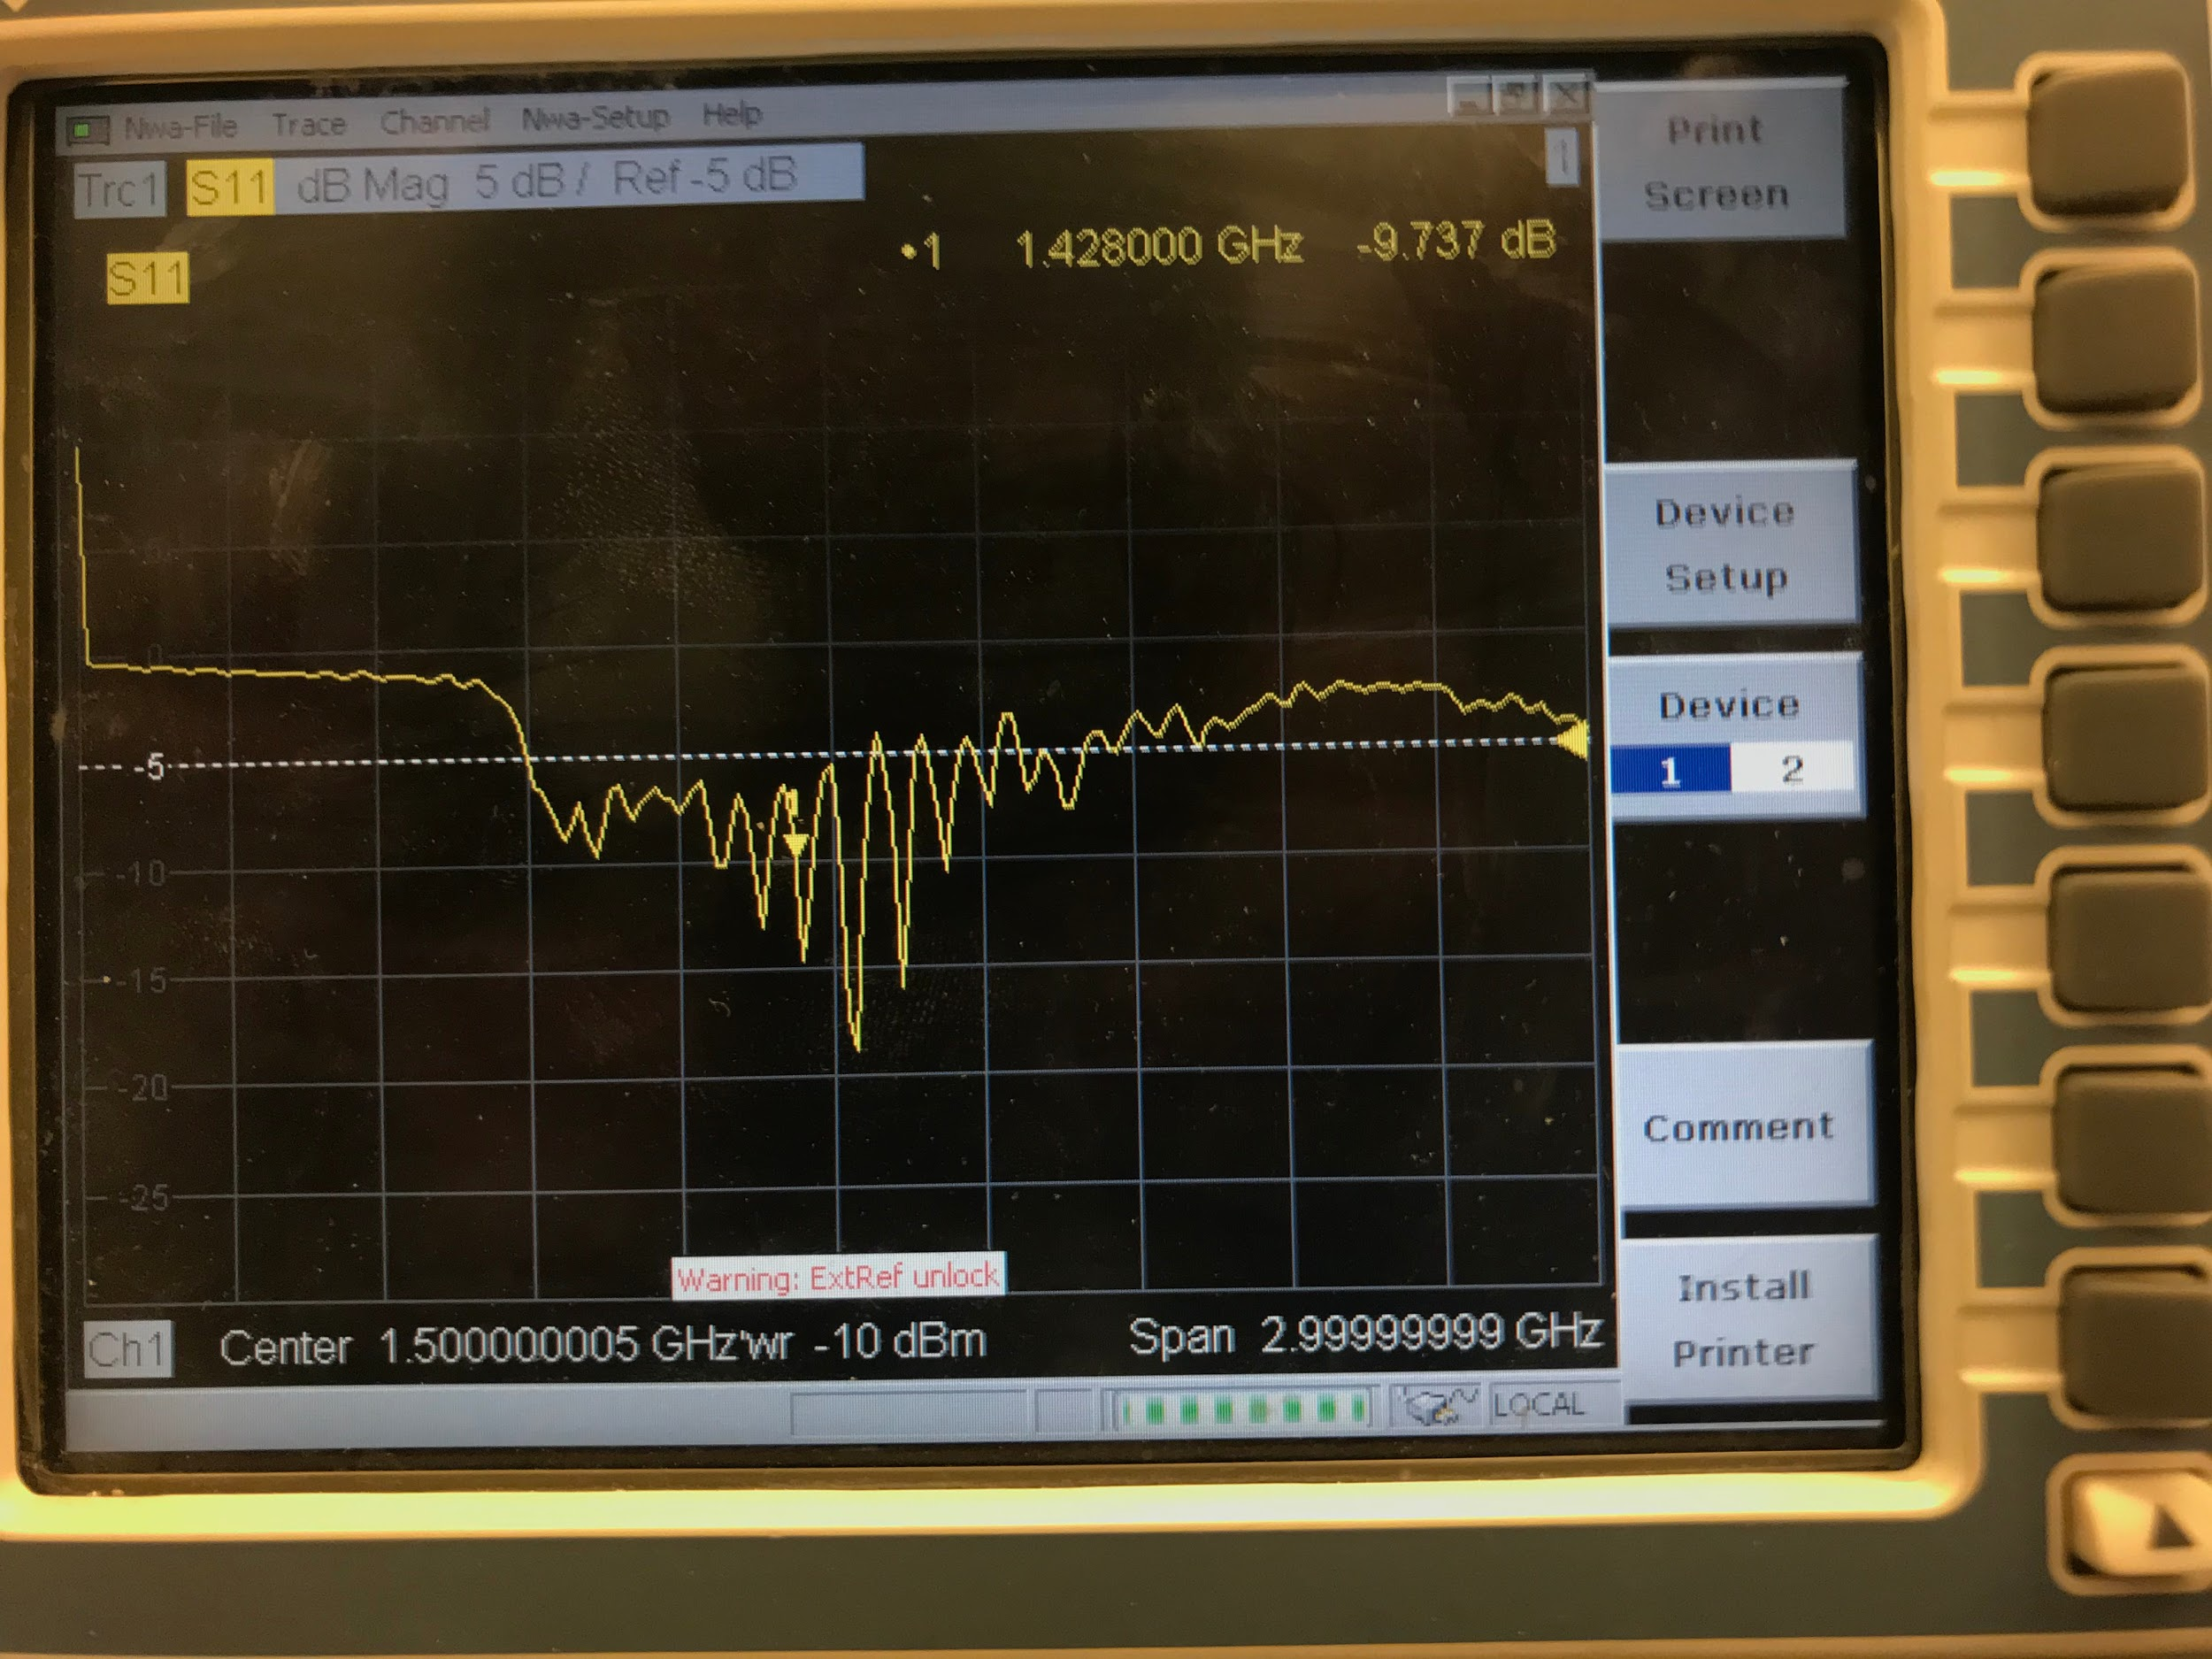
Quarter wave probe tuned with horn
Absorption saturation around 1500MHz
Resonance near 1420MHz

Slide 13
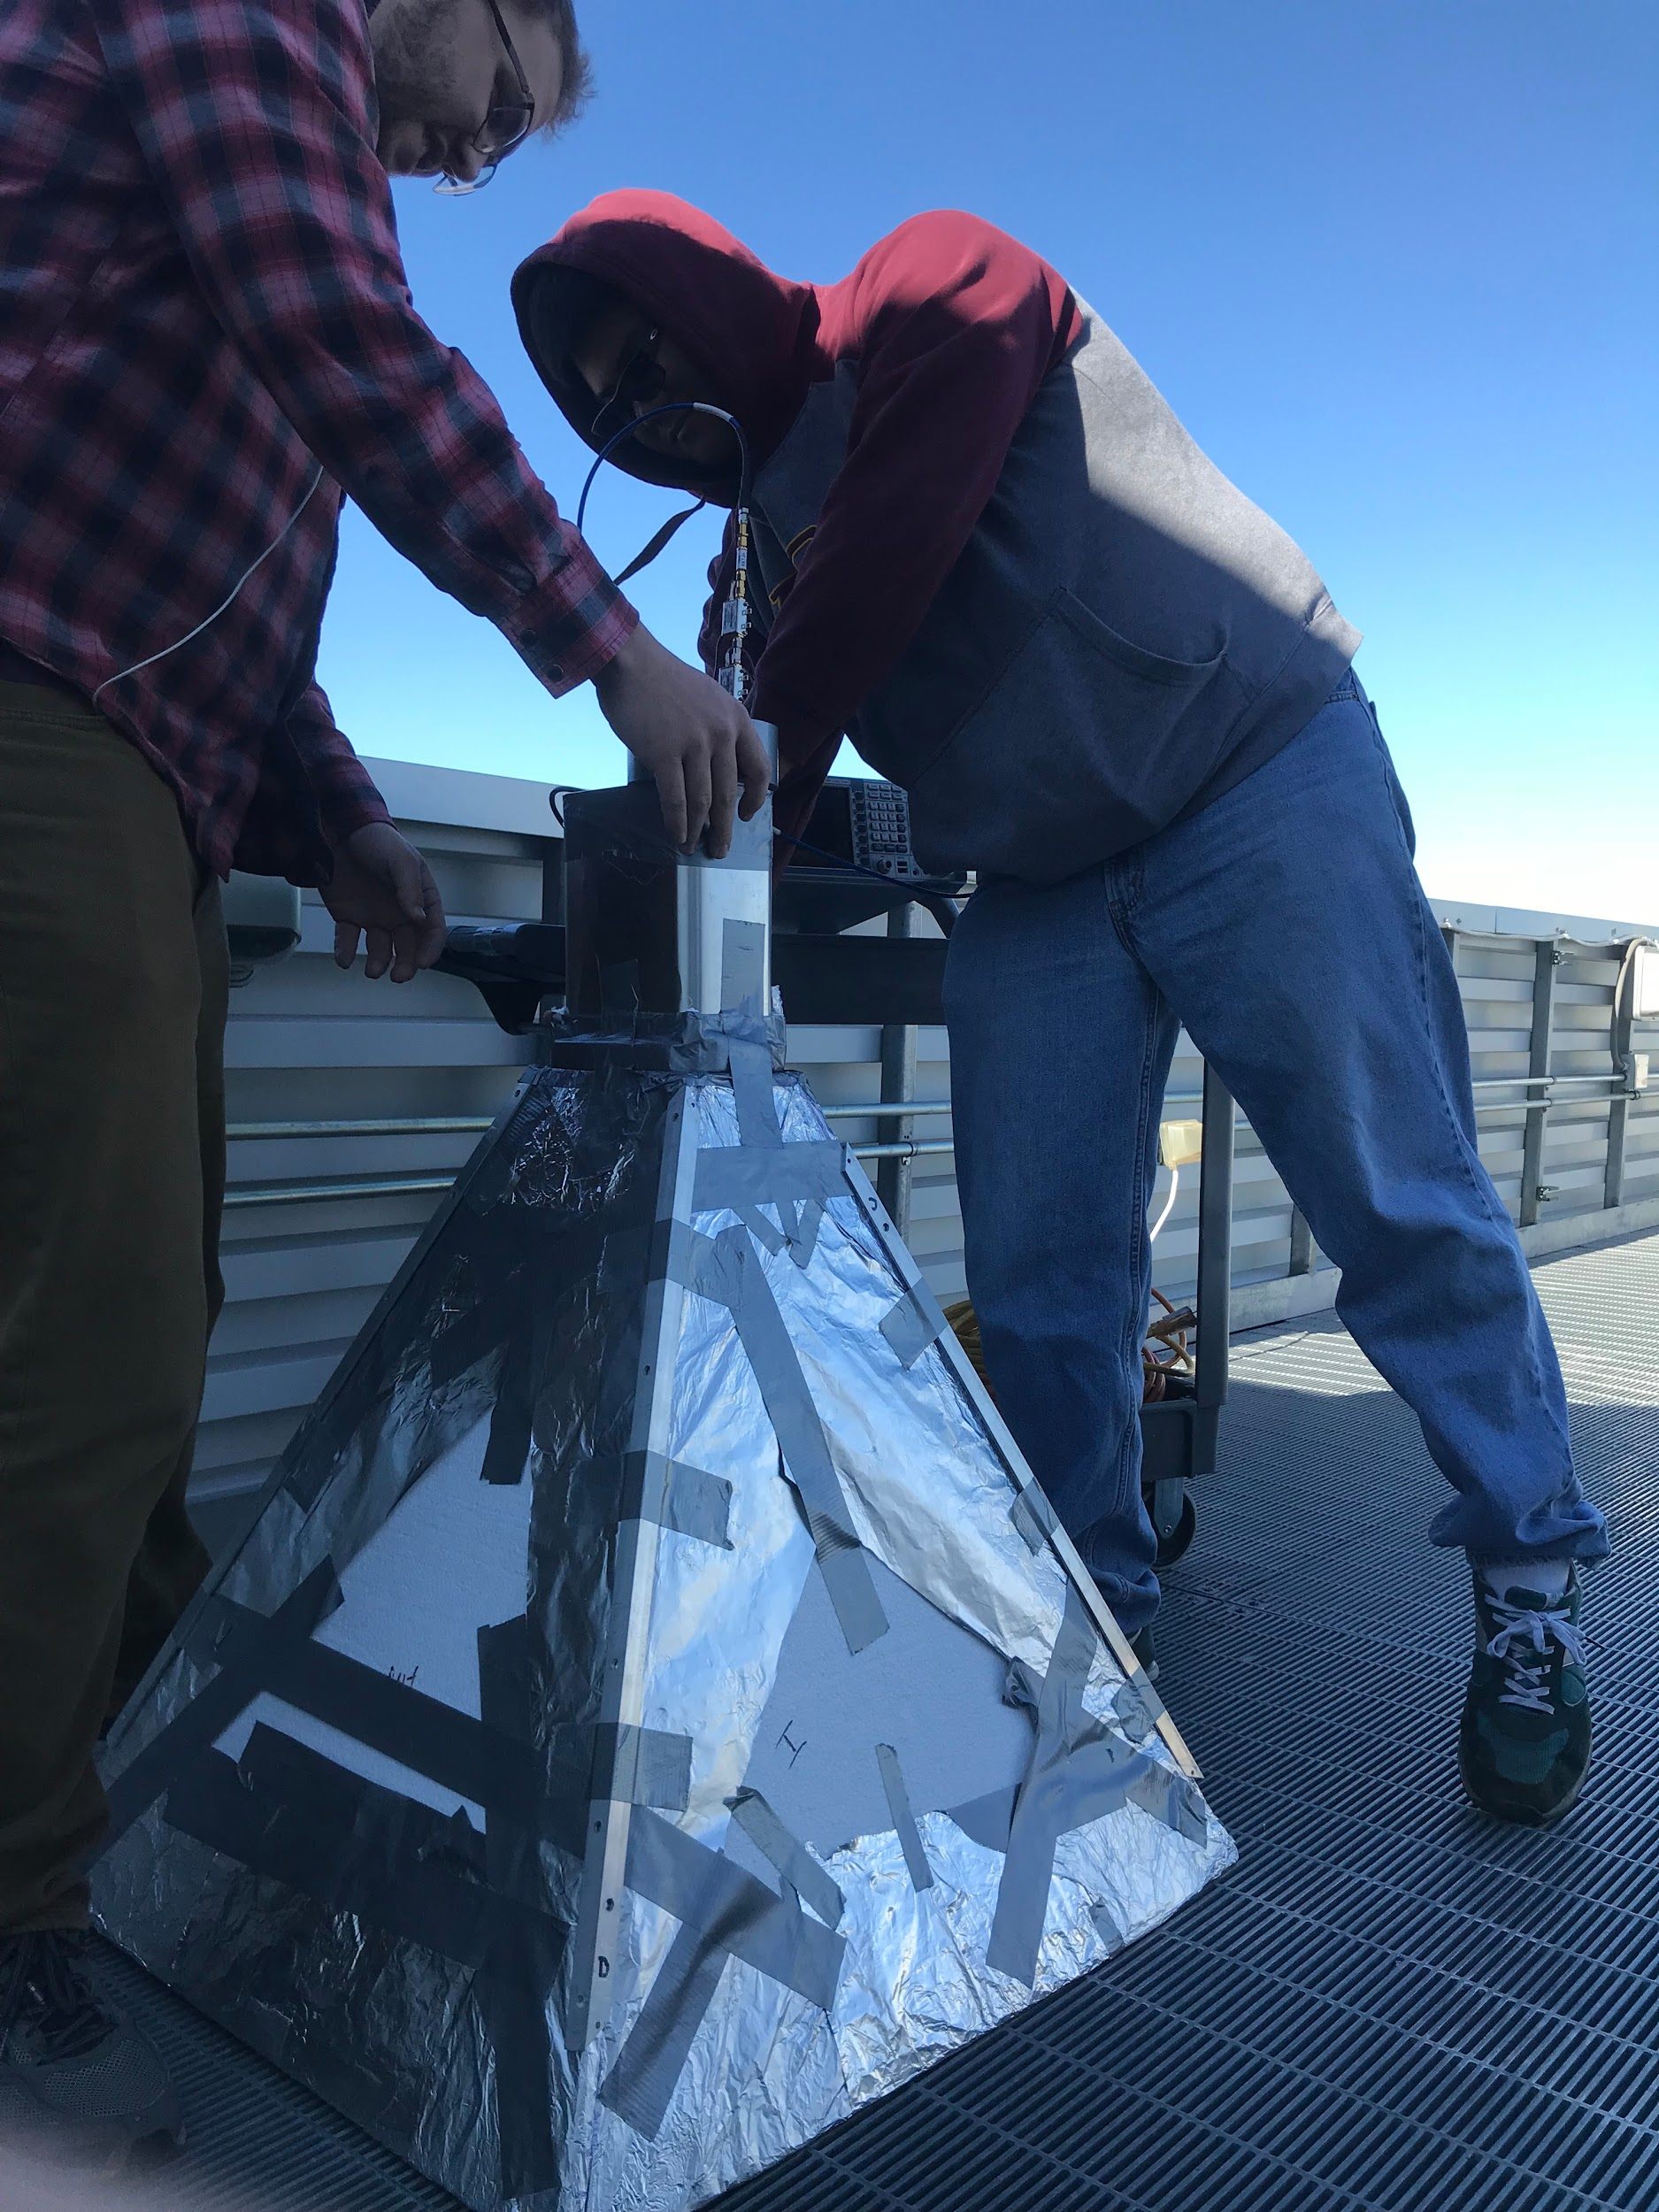
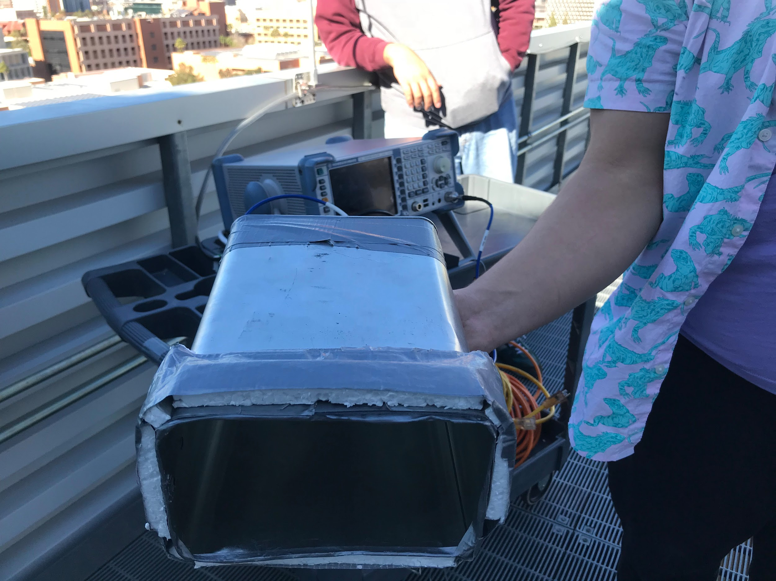
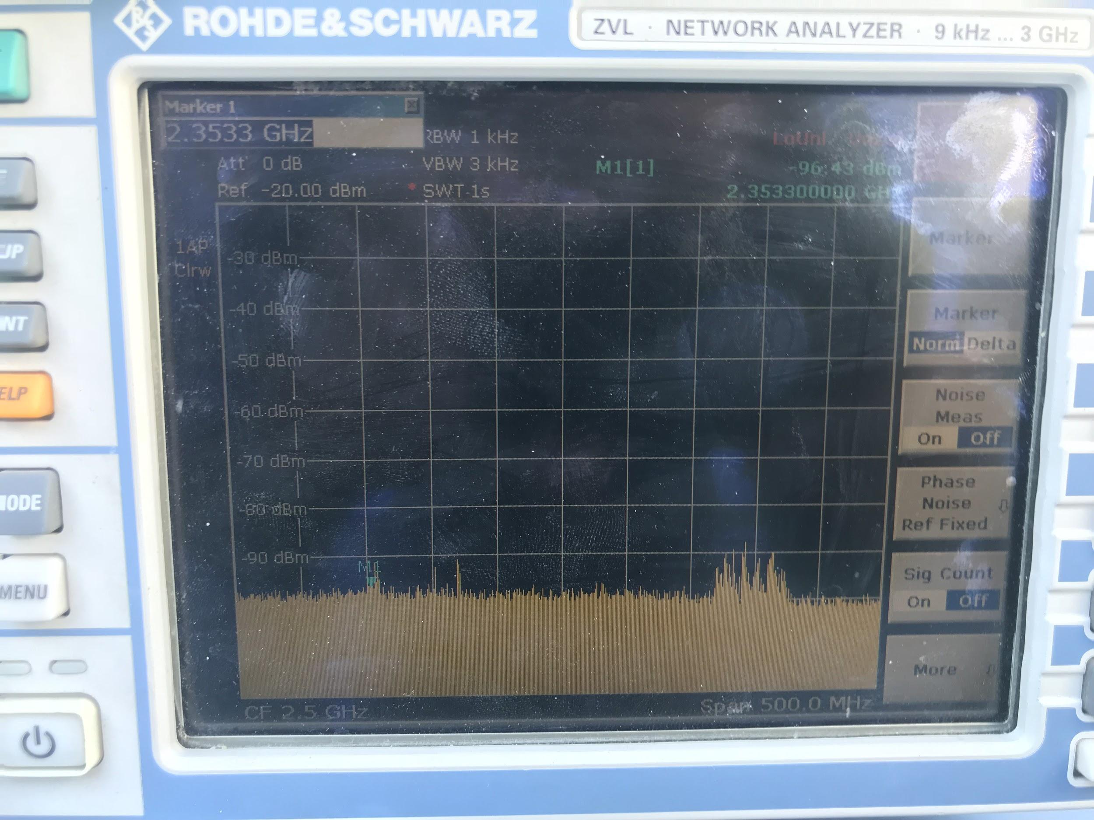
Field Testing: Reference Point

Slide 14
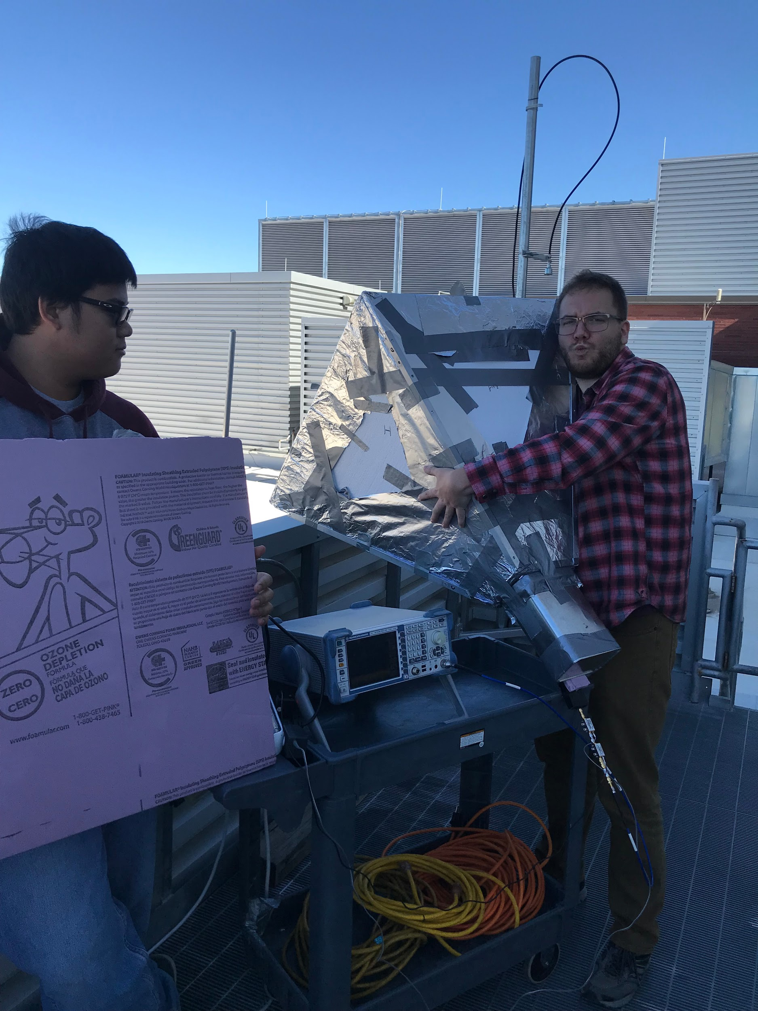
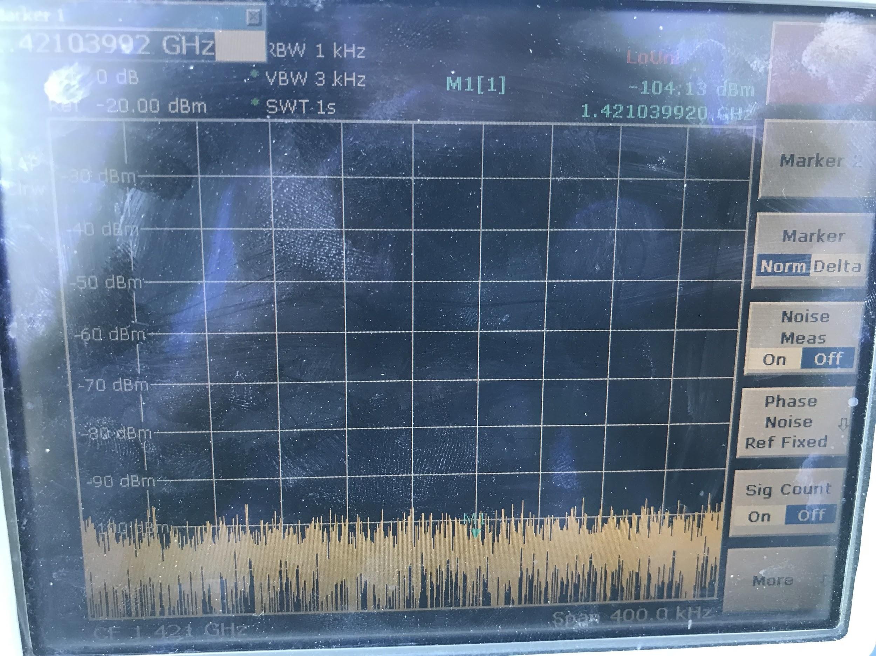
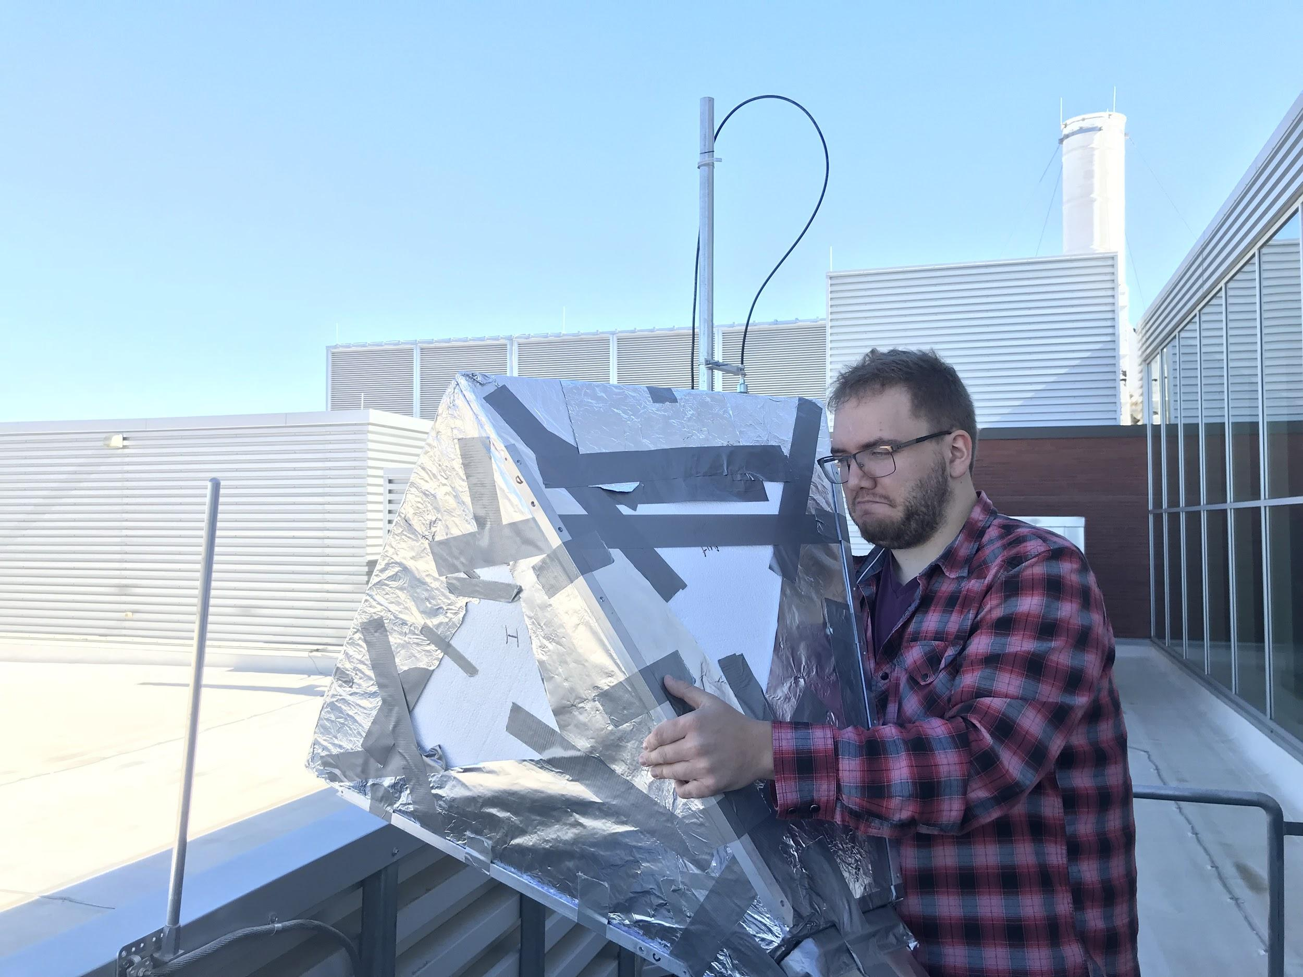
Field Testing: Results

Slide 15
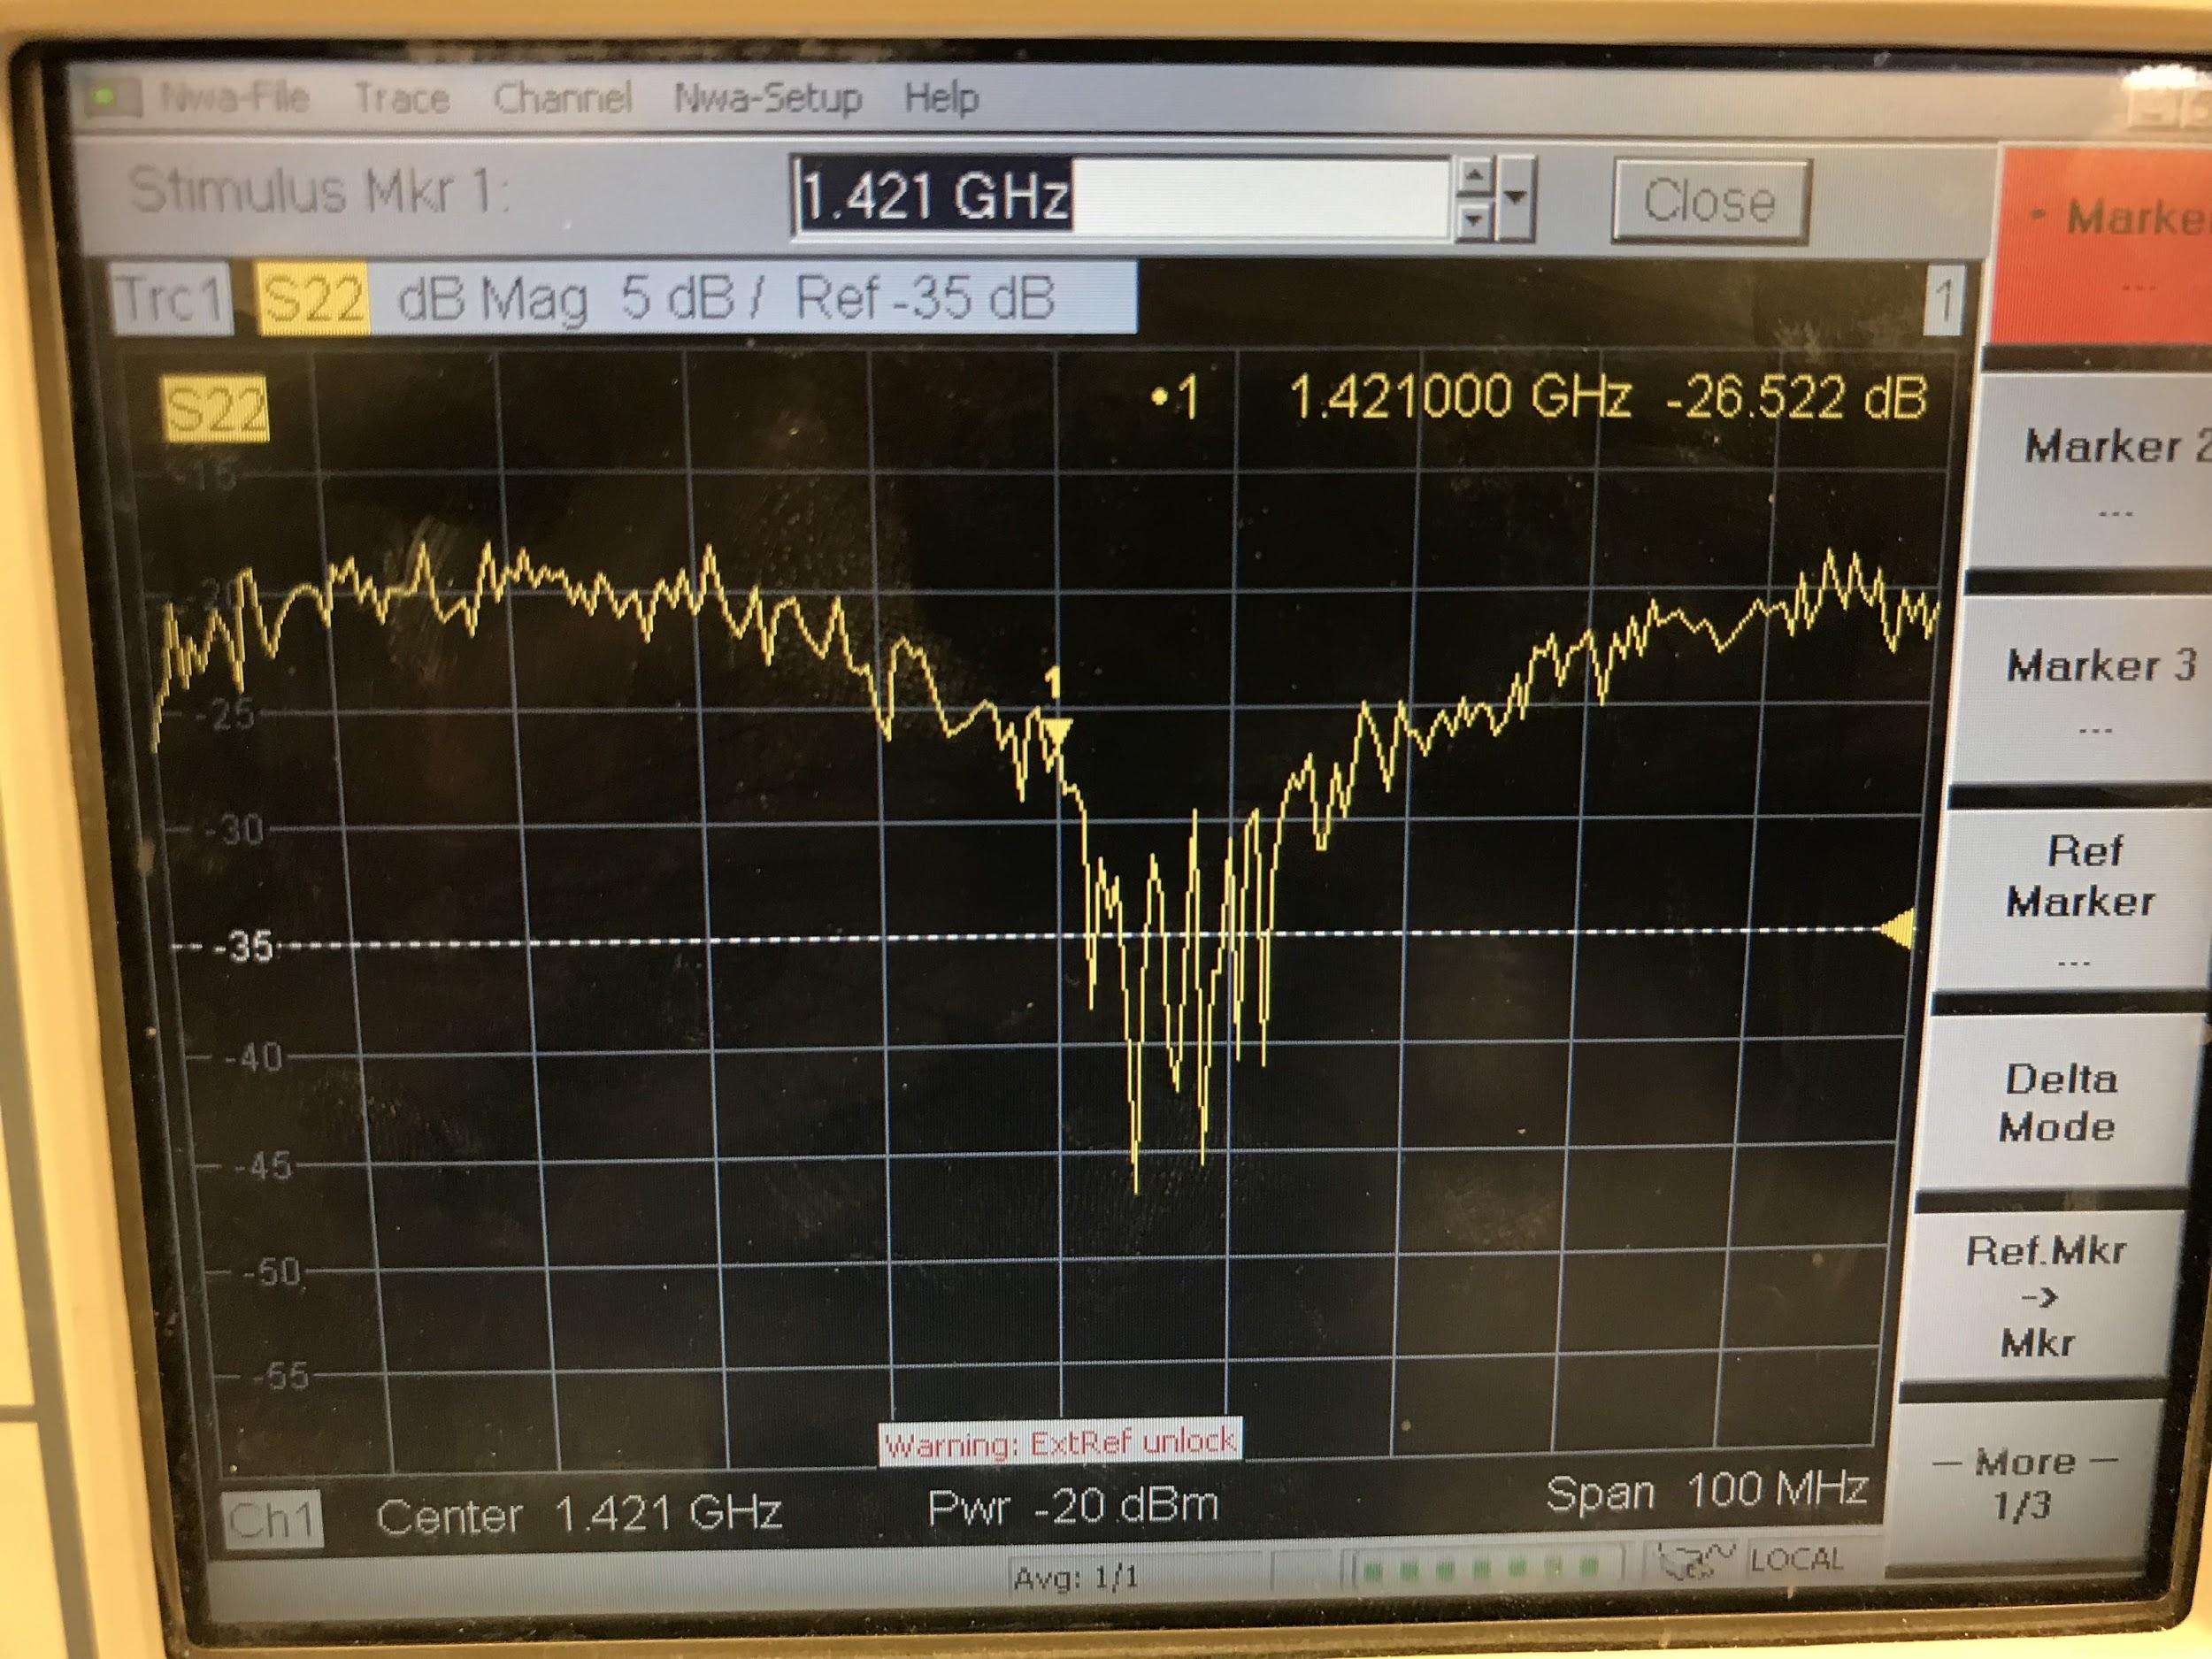
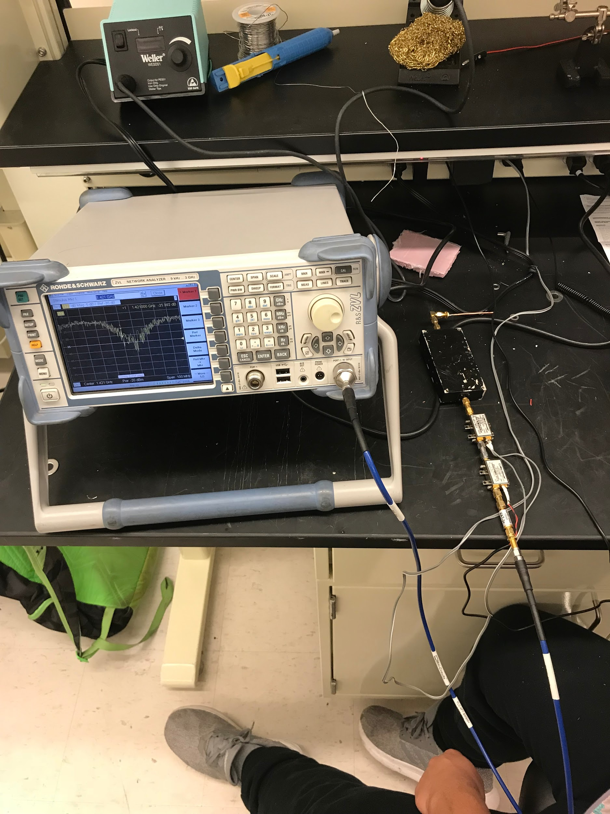
Debugging: RF Front End

Slide 16
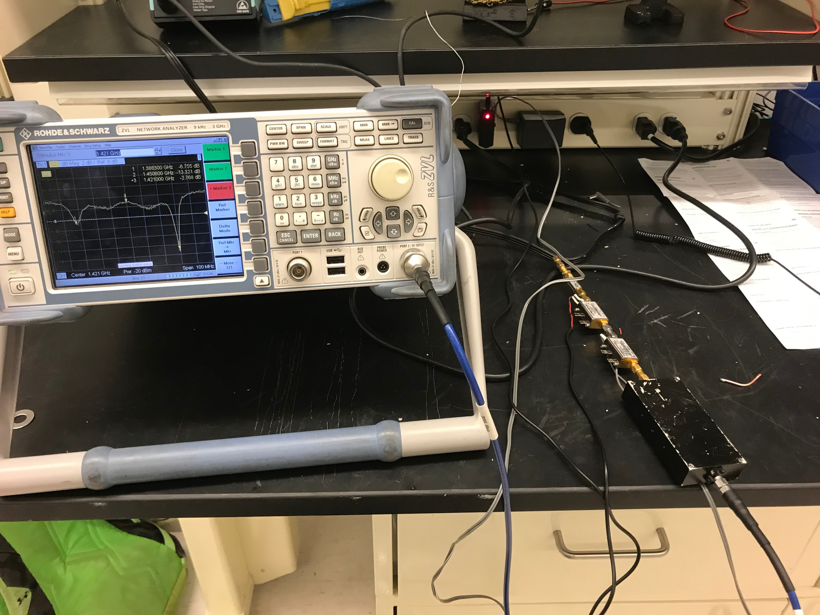
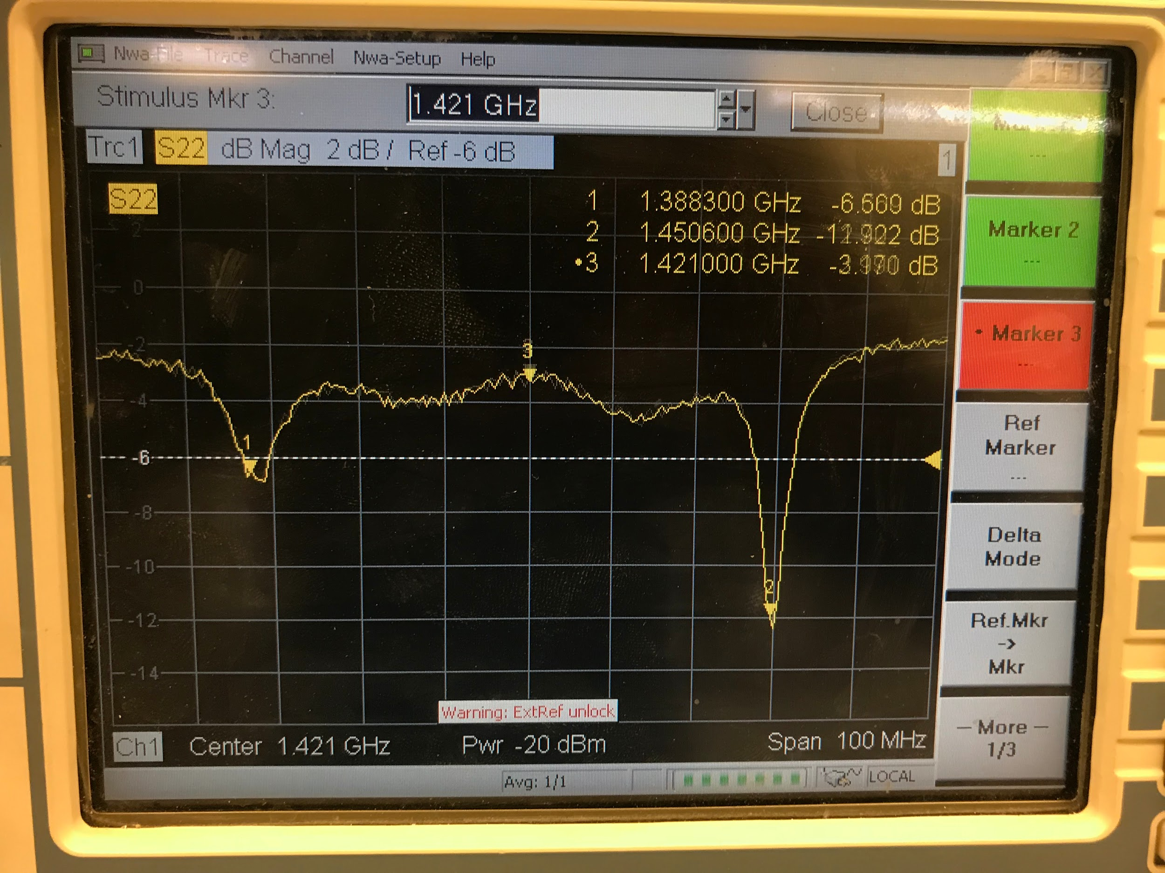
Debugging: RF Front End Part 2

Slide 17
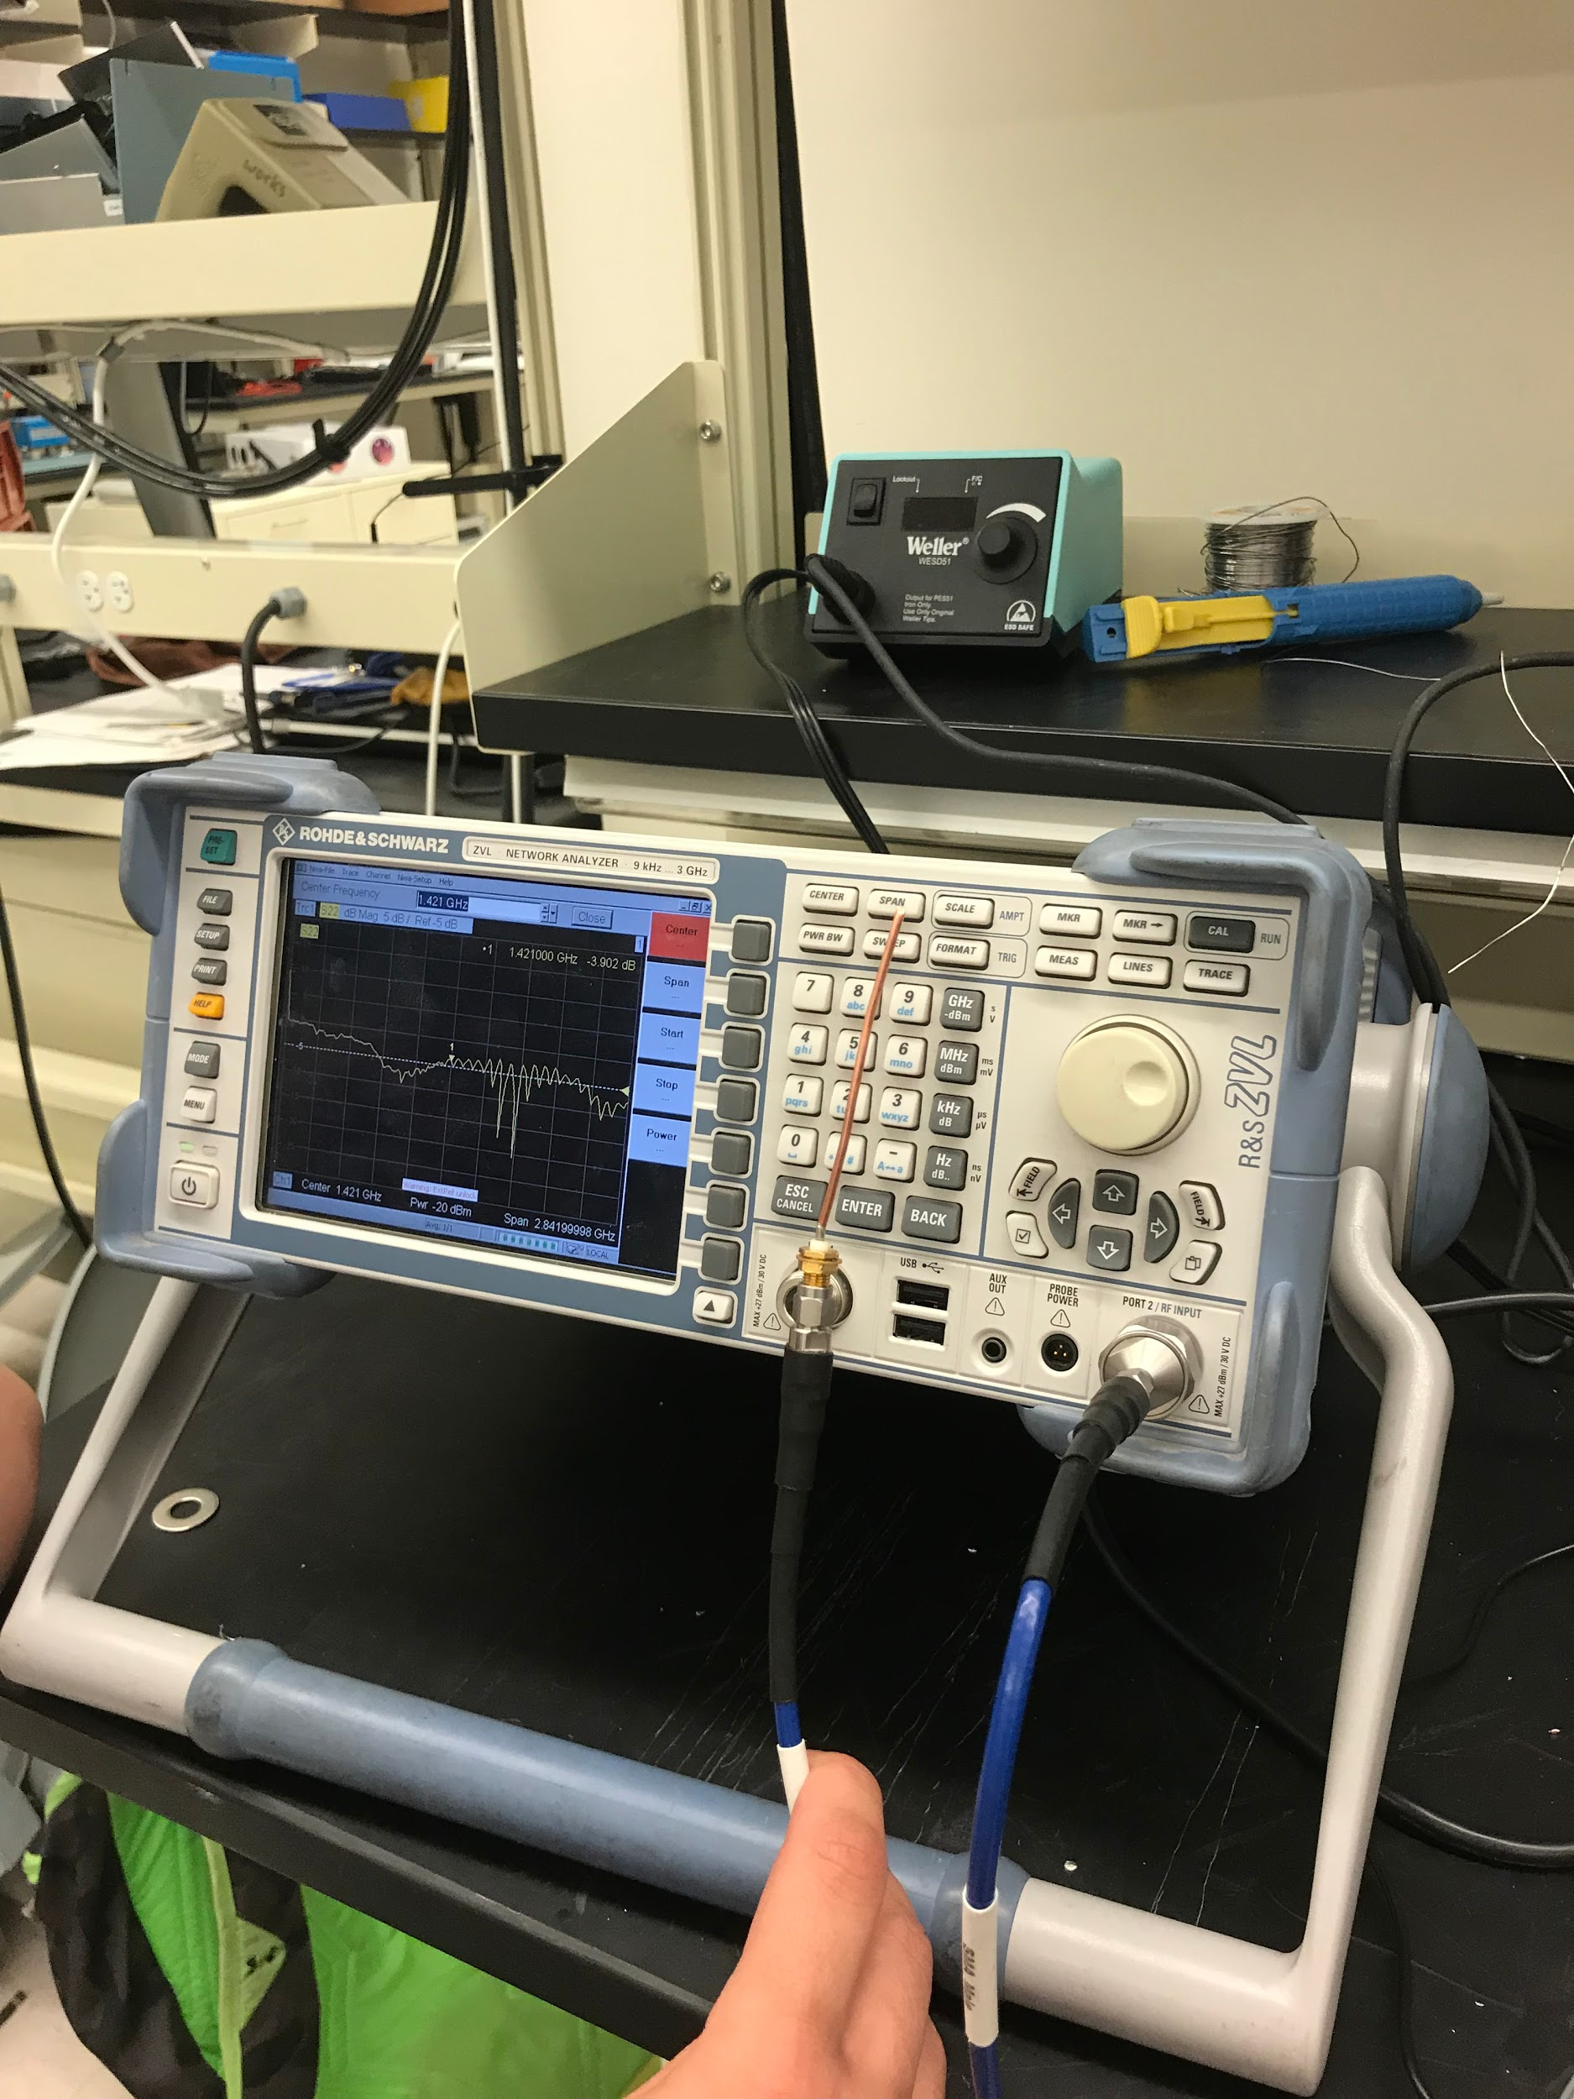
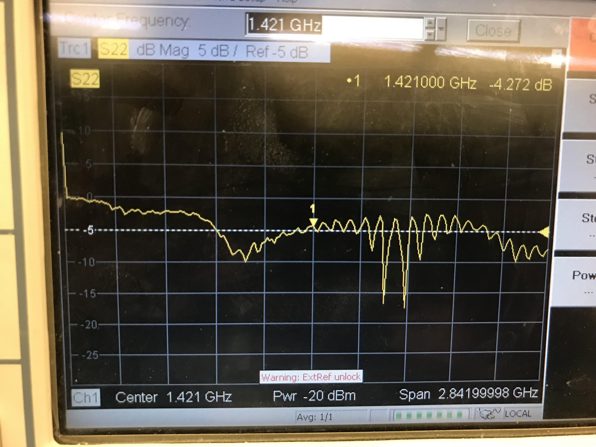
Debugging: Probe

